Slide 1
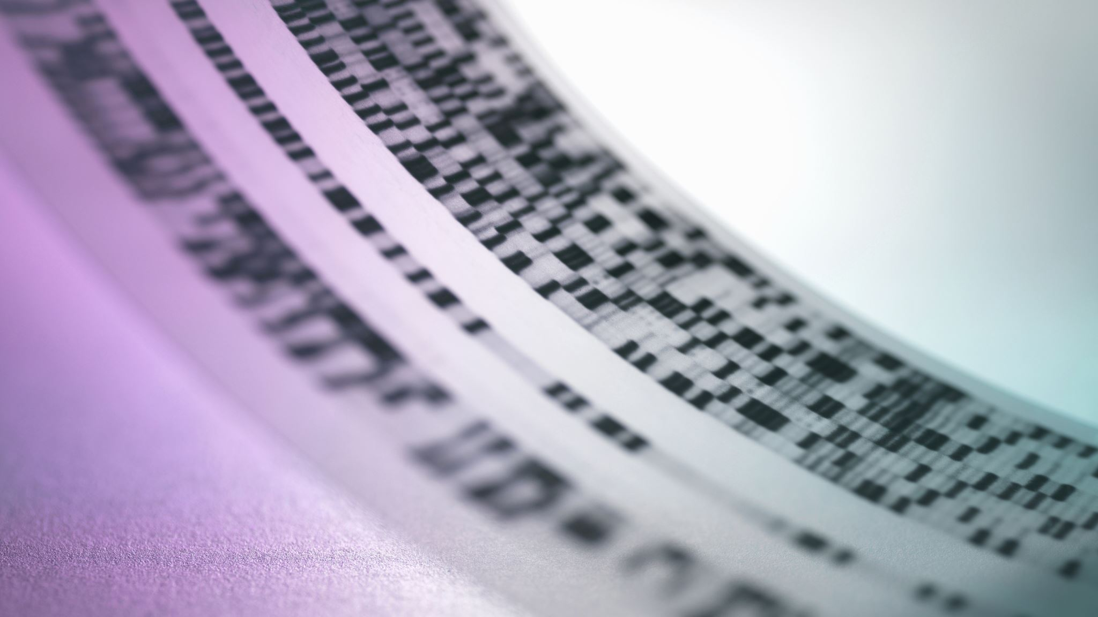
English lessons №11

Slide 2
On the twenty ninth of December we went abroad, to Vilnius. My parents purchased for my, very good and expensive sport shoes. For my brother - Pavel, they purchased a head set but we were been able to purchase in one set, also a keyboard and a mouse. When we were in MacDonald, I spilled a Cola drink. On the New Year Day, we opened a champagne, the cat got afraid and ran away to another room. At eleven thirty we went to the fir-tree. We came back at three a.m. It was interesting. It was a New Year celebration.

Slide 3
6 января мы с женой ездили в Минск. Я ездил по рабочим вопросам, а жена лечить зубы. Погода была не очень хорошая, соответственно дорога была сложная, шел мокрый снег с дождем, температура была -3, но гололеда не было. По дороге мы слушали песню группы Дэнс Манки “Tone and I”. Я перевел эту песню, как о том что кто-то заболел и скоро умрёт или умер, но как оказалось текст песни был совсем о другом. У зубного врача мы были около 3 часов, затем заехали в гости к знакомым, и около полночи поехали домой. В Островец мы вернулись около 2 часов ночи. On the sixth of January me and my wife went to Minsk. I went because of my private works questions, and my wife wanted to visit a dentist. The weather was not very well / good, the road was difficult, it was snowing and raining, the temperature was minus 3 degrees, but it was not slippery. On our way, we were listening to a song ‘Tones and I’ by the group Dance Monkey. I translated the song like about someone is sick and will be dead soon or has already died, but really the translation of the song was completely different. By the dentist we were been about 3 hours, We spent about 3 hours at the dentist’s. Then we met our friends and approximately about midnight we went back to home. We arrived in Ostrovets at about 2 o’clock in the morning.

Slide 4
Dance Monkey
Tones and I
They say oh my god I see the way you shine Take your hand, my dear, and place them both in mine You know you stopped me dead when I was passing by And now I beg to see you dance just one more time
Ooh I see you, see you, see you every time And oh my I, I like your style You, you make me, make me, make me wanna cry And now I beg to see you dance just one more time
So I say Dance for me, dance for me, dance for me, oh, oh, oh I've never seen anybody do the things you do before They say move for me, move for me, move for me, ay, ay, ay And when you're done I'll make you do it all again
I said oh my god I see you walking by Take my hands, my dear, and look me in my eyes Just like a monkey I've been dancing my whole life And you just beg to see me dance just one more time
Ooh I see you, see you, see you every time And oh my I, I like your style You, you make me, make me, make me wanna cry And now I beg to see you dance just one more time
So I say

Slide 5
Dance for me, dance for me, dance for me, oh, oh, oh I've never seen anybody do the things you do before They say move for me, move for me, move for me, ay, ay, ay And when you're done I'll make you do it all again
They say Dance for me, dance for me, dance for me, oh, oh, oh, oh, oh, oh, oh I've never seen anybody do the things you do before They say move for me, move for me, move for me, ay, ay, ay And when you're done I'll make you do it all again
Ooh (all again, all again) Woah-oh, woah-oh, oh Ooh (all again, all again) Ah ah, ah ah, ay
They say Dance for me, dance for me, dance for me, oh, oh, oh I've never seen anybody do the things you do before They say move for me, move for me, move for me, ay, ay, ay And when you're done I'll make you do it all again
They say Dance for me, dance for me, dance for me, oh, oh, oh, oh, oh, oh, oh I've never seen anybody do the things you do before They say move for me, move for me, move for me, ay, ay, ay And when you're done I'll make you do it all again All again

Slide 6
“Dance Monkey” is a song by Australian singer Tones and I, released as the second single from her debut EP The Kids Are Coming. In the track, Tones sings about the struggles of being a musical performer, inspired by her experiences as a busker. She explained to Billboard:
It’s a song about a moment where I felt frustrated about how people had no patience anymore. […] If you replace the word ‘dance’ with ‘sing,’ it’s pretty self-explanatory. I’ve literally turned quotes that people say to me into lyrics – they’re all very real. […] It was one night where people just wouldn’t let me be. I’d been busking for seven or eight hours, and I had done six encores. So many people get inspired in the moment and just make up bullshit to try to give you hope. Every person swears black and blue on their kids’ lives that they’re someone and they can help me and they never do.
“Dance Monkey” was written in October 2018, at her manager’s house. Tones posted a video of herself performing the track the day she wrote it.

Slide 8
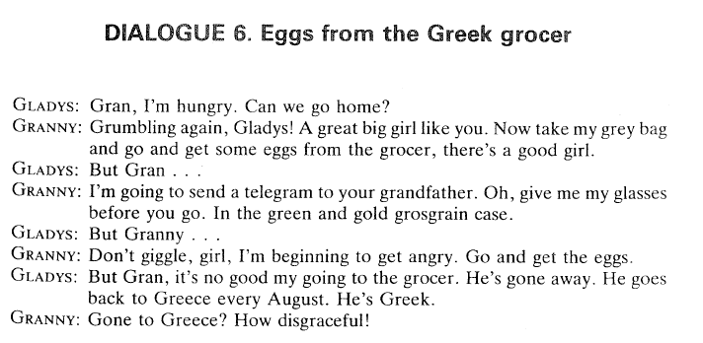
Grumble – ворчать giggle – хихикать
Grosgrain – шелковый поплин disgraceful - позорный

Slide 9
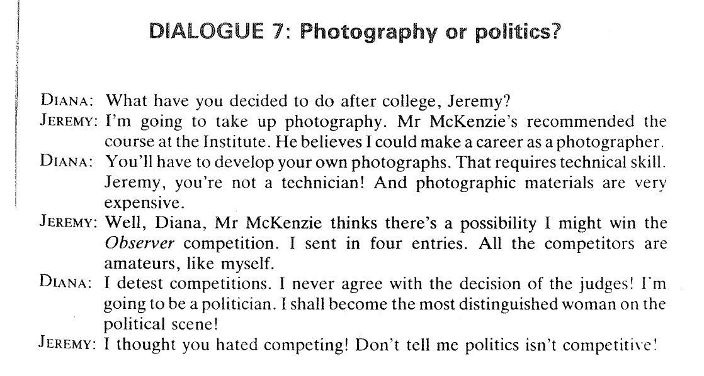
jeremiah

Slide 10
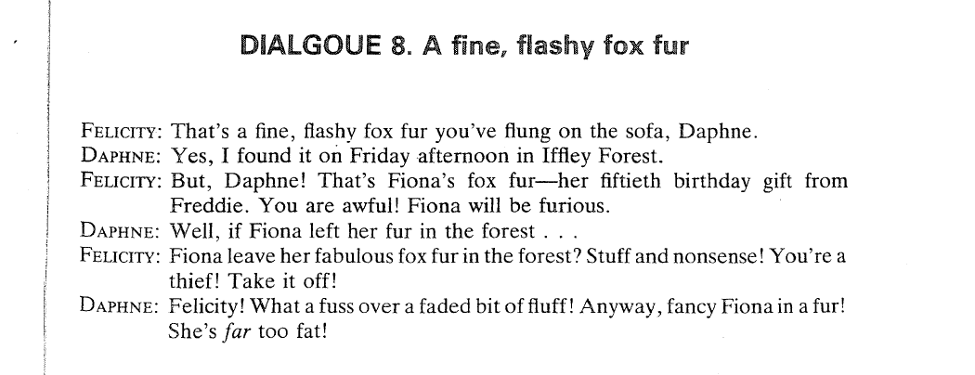

Slide 13
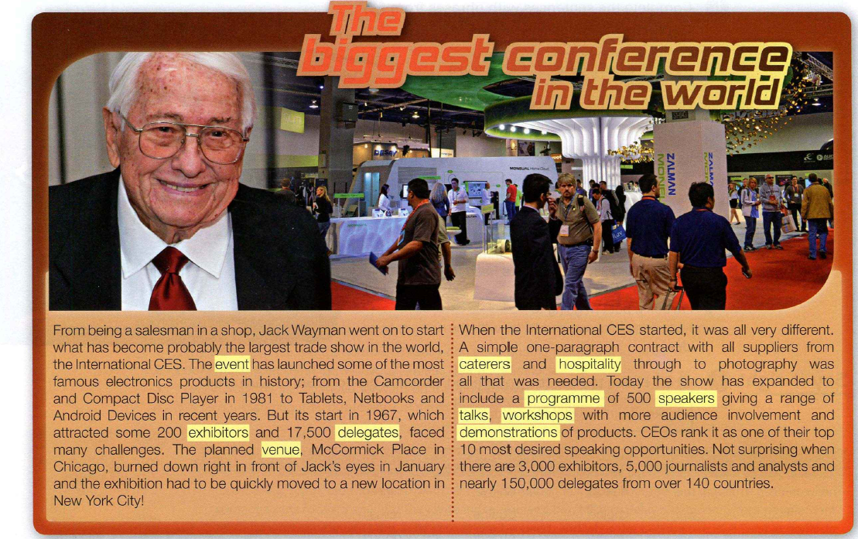
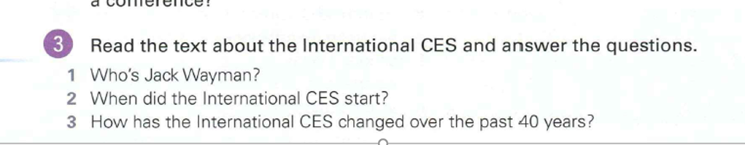

Slide 14
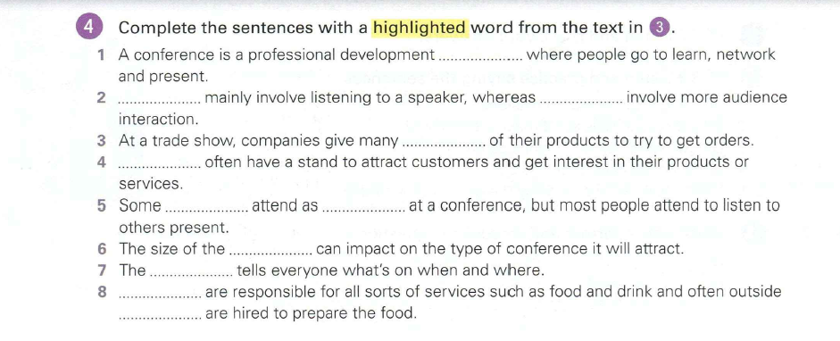
Event
Exhibitor
Delegates
Talks
Workshops
venue

